Slide 1
“Not Only SQL” Picking A Database for .NET
Alex Garland
Notes:
Welcome – who I am …..

Slide 2


About Me
Senior Database Developer
-> MS SQL Server, Hadoop (HDFS)
Senior Data Engineer
-> Hadoop, Hive, Impala, Spark
www.alexdgarland.com www.twitter.com/alexdgarland
Notes:
Background in data analysis, management, development
(Not an expert on OOP/ ORMs!)

Slide 3
In This Presentation…
Theory
Comparison of database systems
Practical code examples!
https://github.com/alexdgarland/database-demos
Architectures

Slide 4

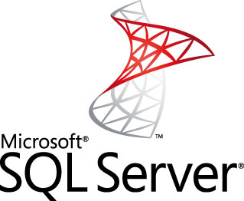


10 Years Ago

Slide 5
10 Years Ago
“OLTP”
Application access, lots of small queries, updates
Lightly Indexed, Normalised
Data Warehouse/ “OLAP”
Large, ad-hoc analytical queries – read-mostly
Heavily Indexed, Denormalised
BUT – all done in SQL/ Relational

Slide 6
Relational Dominance
1970s – Early 2000s
E.F. Codd - “A Relational Model of Data for Large Shared Data Banks”
Widespread Adoption, Heavy Vendor Investment

Slide 7
Relational – The Good Parts
Flexible - Good “All-Rounder”
Plain-English Query Language (SQL)
Strong Theoretical Basis (Maths/ Logic, ACID)
Mature Technology

Slide 8
So What’s Not To Like?
Object-Relational Impedance Mismatch
Separation of Skill-Sets/ Expertise
Scalability
Notes:
(Audience Participation)

Slide 9
Object-Relational Impedance
Fundamental difference in programming/ data model
ORMs – increased complexity, unreliable performance?
http://www.nogginbox.co.uk/blog/reviewing-my-data-access-using-entity-framework-profiler

Slide 10


Separate Skill-Sets
Developer
DBA

Slide 11
Separate Skill-Sets
“Can We …”
“No”

Slide 12
Separate Skill-Sets
“We Need To Optimise …”
“We Don’t Have Time”

Slide 13
Can We Improve Relational?
MS SQL Server
XML Data
Binary Storage
FileStream
(etc. ….)
BUT – very expensive way to get non-relational features!

Slide 14
PostgreSQL
Open-source relational database
“Object-Relational”
Rich type system
Runs okay on Windows or Linux
Notes:
Even using what is basically still relational database software, there are some things we can do to work a bit more easily with application code.
SQL Server gives us some options (e.g. XML, binary storage) but I’d like to quickly show you some cool features in a database I’ve been learning about in 2014 - PostgreSQL.

Slide 15
PostgreSQL - Demos
Table Inheritance
Type System
Arrays
IP addresses
JSON storage
Notes:
Let’s take a quick look at how some of these features work.

Slide 16
So…
What About Scalability?
Notes:
So getting a little bit more clever in how we select and use a relational database may help a bit with how our code interfaces with the database, and may make the gap in skill-sets less pronounced. But what about my third point – scalability?

Slide 17


Vertical Scaling
Notes:
Vertical scaling means that when we are scoping a larger project, or adding capacity to an existing solution, we increase the resources allocated to each of one or more existing servers. So more/ more powerful CPU cores, more RAM, bigger and faster disks, etc.

Slide 18
Vertical Scaling
Simple – No Change to Fundamental Architecture
BUT:
Expensive – Non-Linear Cost Increases
Increasingly Specialist Hardware
No Redundancy

Slide 19
Horizontal Scaling
Notes:
The alternative is horizontal scaling. We don’t increase the size of the boxes but …
(SHOW ANIMATION)
…we use more of them.

Slide 20
Horizontal Scaling
Linear (or better) increases in cost to scale
BUT – increased complexity of architecture/ programming model
Especially challenging for data storage

Slide 21
Horizontal Scaling – “Read-Mostly”
Master-Slave Replication
Slaves
Read Traffic
Write Traffic
Load Balancer/ App Server(s)
Write Replication
Master
Notes:
The feasibility of scaling horizontally really depends on the required workload. If we’re dealing mostly with reads, we can use what’s called master-slave replication. Basically, there is still one definitive version of the data – the master – and all writes are sent there. We then push data out (replication techniques vary…) to copies of the master – these are the slaves. These multiple servers allow us to respond to many more read requests.
The key thing to note here is that there is still only a single server for the write workload, and if anything it is doing more work than before (it also has to do some sort of work to broadcast changes to the slaves). So if we have a lot of writes, we are going to either run into the same problems with vertical scaling as before, or need to move to an alternative (probably more complex) architecture.
NB: A “write-heavy” workload doesn’t need to mean a majority of requests are writes, just that there are enough that this architecture of having one master, many slaves is not going to work.

Slide 22
Horizontal Scaling – “Write-Heavy”
Database Sharding
Write Traffic
Read Traffic
Data Distribution Strategy
Shard A
Shard B
Shard C
Shard D
Notes:
One of the main ways that most database systems (including relational) can be scaled up horizontally for write workloads is through sharding.
At the highest level, sharding is relatively straightforward. We store distinct parts of the data on each of several nodes. Each node handles both reads and writes, so we can handle plenty of both types of traffic.
However – the devil is in the detail – what strategy do we use to distribute the data? – making sure our application knows where to send data to and retrieve it from? How do we make sure we keep data sufficiently and evenly distributed? This can add complexity to sharding, and traditional relational databases don’t always make this easy “out of the box”.

Slide 23
What is NOSQL?
#nosql - “No SQL” or “Not Only SQL”
Early 2000’s – “Web-Scale” companies
“Big Data” – 3 V’s
Volume
Variety
Velocity
Tools for Massively Distributed Systems
Notes:
So now we’re starting to see some of the limitations of traditional database approaches. It’s time to focus a bit more clearly on what we mean by “NoSQL”.
Firstly, the term itself – it can be interpreted as excluding SQL and relational altogether, or the “NO” can be interpreted as meaning “Not Only”, implying a more mixed approach of the right database for the right problem.
This broader interpretation is probably more helpful for general-purpose usage.
The original idea of getting away from relational as the main storage medium came from “Web-Scale” companies like Google, Amazon and later social networks like Facebook.
They faced the challenge of building massive distributed systems with “Big Data” meeting the “Three Vs” conditions. This meant they were brought up sharply against the limits of relational databases.
These are companies that pride themselves on having highly-skilled engineering teams, so they started to build in-house systems which helped them manage data on this scale as well as maintain and scale clusters relatively easily. Some of their work (e.g. Google BigTable & GFS, Amazon Dynamo) was published as white papers and was an early influence on the wider NoSQL movement, which has grown since then
In particular there have been a number of freely-available open-source “NoSQL” systems created and released.

Slide 24
CAP Theorem
Eric A. Brewer.
“Towards robust distributed systems”
Principles of Distributed Computing, Portland, Oregon, July 2000
https://www.cs.berkeley.edu/~brewer/cs262b-2004/PODC-keynote.pdf
Seth Gilbert, Nancy Lynch
“Brewer’s Conjecture and the Feasibility of Consistent, Available, Partition-Tolerant Web Services”
ACM SIGACT News Volume 33 Issue 2, June 2002
http://webpages.cs.luc.edu/~pld/353/gilbert_lynch_brewer_proof.pdf

Slide 25
CAP Theorem
We can guarantee (at most) two of:
Consistency
Availability
Partition Tolerance
Notes:
This is the CAP theorem in its simplest form. So at face value at least, a classic engineering trade-off – “pick any two”.
We’ll need to unpack this a little bit more, particularly to understand what we mean by these three properties.

Slide 26
Consistency
NOT the same as ACID “Consistency”
All nodes see the same data/ history
Various strengths of consistency guarantee
e.g. http://www.bailis.org/blog/linearizability-versus-serializability
Notes:
Consistency is not the same as the “Consistency” of ACID database properties (which is more to do with logical integrity and invariants). CAP “Consistency” is closer to ACID “Isolation” – we get some level of ability to reason about data as if it were being acted on sequentially on a single machine.

Slide 27
Availability
All non-failed nodes must be able to respond to any request
Tends to be associated with (but not the same as) low latency
Notes:
High latency/ delay is impossible to cleanly identify vs complete failure, non-availability.
At extreme - latency approaching infinity [or operationally, some unacceptably high value - timeouts/ SLAs etc.] is effectively equivalent to non-availability.

Slide 28
Partition Tolerance
System can operate in conditions where nodes may fail or be unable to communicate
All real distributed systems MUST be partition-tolerant
So – choose CP or AP
blog.cloudera.com/blog/2010/04/cap-confusion-problems-with-partition-tolerance
Notes:
Practically speaking, any real-world distributed system must deal with the possibility of failure – delay in network communication, server garbage collection etc. count just as much as complete network partition/ node failure.
& the larger the system gets, the more expected hardware failures become. E.g. mean time to server failure = 3 years –> with 1000 servers you expect to average around 1 failure per day.
So in reality we have to decide, when these failures (“partitions”) happen, do we favour consistency or availability – the other cannot be guaranteed.

Slide 29
CAP – A Simple Example
Network partition
a = 1
UPDATE: a = 3
a = 1
a = 1
a = 1
a = 1
UPDATE: a = 2
Notes:
So to give a simple example – say we have five nodes which are collaborating to manage the same data. They might be part of a wider cluster, but these five all contain a record of the value for “a”. At first, all the nodes can communicate happily – and so if there is a change to the value of “a”, they all know about it and stay in sync with minimal latency.
HOWEVER (ANIMATION 1) – if we split them in half with a network partition, we have more of a problem. Not all the nodes can share information. If an update comes in during the partition (ANIMATION 2), we have a choice:
Allow the write on the nodes that can receive it. That means these nodes on the bottom right can get the new value and acknowledge success to the application. This is favouring availability, but then these nodes have a different value from those on the top left, so losing consistency. This is especially a problem if we also get a new update to the top-left partition (ANIMATION 3) – now we don’t even have a consistent HISTORY of updates – when the partition heals, we have to decide which update to keep/ which is the latest in the global “history”.
Alternatively, we can delay acknowledging and committing the write until all nodes can respond. This preserves consistency (all nodes have value 1, up until the point they can all accept value 2) but means we cannot write data while the network is partitioned – so availability is lost.
Traditional databases tend to be CP (favouring consistency) – one of the key insights of the NoSQL movement is that sometimes it is possible – and desirable - to favour availability.

Slide 30
MongoDB
Open-Source Document Database
“CP” – Favours Consistency
BUT – Still Makes Distributed Storage Easier
Notes:
Using this new terminology, we can take a look at some “proper” NoSQL systems and categorise them accordingly.
MongoDB is a common (and reasonably good) place for developers to start with NoSQL, as it is decent at scaling up while still being basically “CP”, and (perhaps more importantly to many devs!) it avoids the impedance problems of relational DBs by storing data as BSON (binary JSON) documents.

Slide 31
MongoDB - Demo

Slide 32
MongoDB - Sharding

Slide 33
Document Databases
GOOD | BAD
Straightforward object storage | Less safety around data integrity
Flexible (implicit) schema | Pushes more work to application
Eliminate many joins | Optimised for certain query patterns; relatively poor at multi-document aggregates
Notes:
So we can look at the pros and cons here of both document databases in general, and MongoDB in particular.
Firstly – in general. As we’ve seen, the document model is very straightforward and flexible to use in storing serialised objects, in comparison to the relational model. We can:
tailor the storage format to the specifics od our object
change it at will and
store related data in a single document – which means we don’t have to worry about the performance impact of joins on large tables.
However – there is some cost associated with this flexibility. The fact that the database doesn’t impose a schema means that there is less protection around the fundamental rules governing our data. & what protection/ checking there is, must be done in our application. It’s not the case that there is no schema – the schema is implicit, we still need to think about it and not (e.g.) slightly change field names that refer to the same data in different parts of the application. Think of it as similar to the difference between static and dynamic type checking in application programming languages.
Pre-aggregating data also provides less inherent query flexibility than the relational model – we are optimising for the data structure we expect the application to use. In particular, there may be more work to generate summary figures across multiple documents.
BUT – a) indexing (not looked at in depth, suspect slightly less mature than relational systems) and b) polyglot persistence – will discuss later how we might use more than one database for different strengths.

Slide 34
MongoDB
GOOD | BAD
“CP” behaviour makes consistency straightforward | Loses transactions/ ACID guaranteess for multi-document transactions
Automatically handles sharding | Less available than some “AP” systems
Popular/ widely used
NB: Document databases can make other trade-offs:
-> RavenDB – stronger ACID semantics
-> CouchDB – prioritises availability (“AP”)
Notes:
Within this field, we can see that MongoDB makes a particular set of trade-offs.
So it is relatively consistent, but less so than a classic relational database in some edge cases (note that the nested aggregate structure makes multi-document transactions fairly uncommon with a well-designed schema).
It scales relatively well due to built-in sharding, but not as aggressively as a pure AP system (which we will see more of in a minute).
If these seem like the right trade-offs for your project, MongoDB is well worth looking at, especially as it is relatively widely used for a NoSQL database.

Slide 35
“AP” Systems – Riak & Cassandra
“Aggregate” data models – somewhat similar to document databases
Highly optimised for availability
Tunable AP/ CP trade-off
Notes:
We’re going to look at two AP systems, Riak and Cassandra, which share some key features but also have some clear differences.
I have looked at Riak in the most detail, as it is the clearest example of an AP system and the key trade-offs made.
For Cassandra will simply highlight the differences, which are mainly around having a more detailed & expressive data model which parallels relational/ SQL to some (limited!) extent.
http://docs.basho.com/riak/1.1.0/references/appendices/comparisons/Riak-Compared-to-Cassandra/
Please note that this is by no means a complete overview of AP systems and there may be other ways to implements, but these are representative and widely used examples!

Slide 36
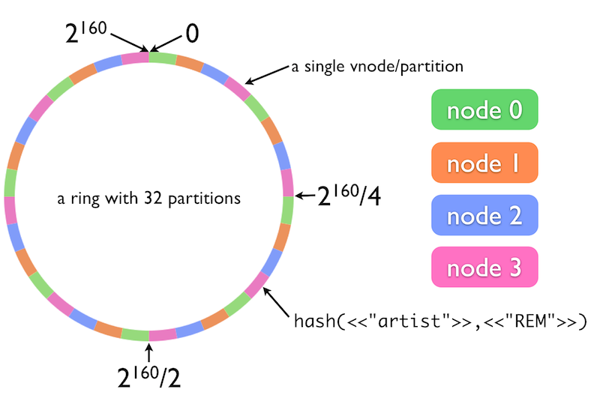
The Ring Model
http://docs.basho.com/riak/latest/theory/concepts/
Notes:
This is a model for data and load distribution that is shared by Riak and Cassandra (diagram is from Basho (Riak) website – but same principle), and has a deep impact on how they store, manage and retrieve data.

Slide 37
Tunable Consistency
Immediate vs Eventual
N, R & W Values – Strong, Quorum, Weak
“Read-Your-Writes”
Notes:
http://docs.basho.com/riak/latest/dev/advanced/cap-controls/
http://docs.basho.com/riak/1.1.0/references/appendices/concepts/Eventual-Consistency/

Slide 38

N, R & W
b = 10
c = 20
a = 1
a = 1
a = 2
b = 10
c = 20
a = 2
a = 1
b = 10
c = 20
N (total replicas) = 3
Satisfies R =
(minimum acknowledged writes)
1
2

Slide 39
Riak
GOOD | BAD

Slide 40
Riak - Demo

Slide 41
Cassandra
GOOD | BAD

Slide 42
Cassandra - Demo

Slide 43
MapReduce
Method of aggregating data from multiple nodes
“Send the work to the data”
Implemented in Riak, MongoDB, Hadoop (etc.)

Slide 44
MapReduce
(PUT DIAGRAM HERE)

Slide 45
Hadoop
Not a database!
Core tools
Wider ecosystem

Slide 46
Hadoop – Core Tools
Local File System
Hive
Pig
(Java API)
Map
Reduce
PUT
GET
HDFS
Hadoop Distributed File System

Slide 47
Hadoop MapReduce - Demo

Slide 48
Apache/ Hadoop Ecosystem

Slide 49
Graph Databases – Neo4j
Based on Graph Theory (Euler et al.)
“NoSQL” in that not relational – but not “standard” NoSQL
Neo4j is a popular open-source implementation
Notes:
Similar to relational databases, graph databases are implemented based on mathematical theory. In this case – graph theory, dating back as far as the work of Leonhard Euler in the 18th century.
They also have some other similarities with relational which mean that although they are often categorised as “NoSQL”, in some ways they are more similar to SQL Server than systems such as Riak, Cassandra or even MongoDB.

Slide 50
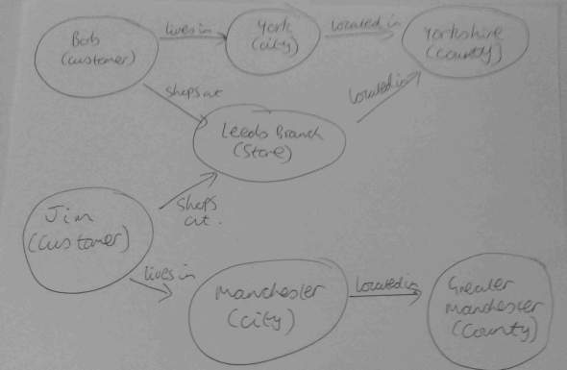
Neo4j - Demo
Notes:
The best way to understand the basics of Neo4j is by example – so. let’s go straight to a demo

Slide 51
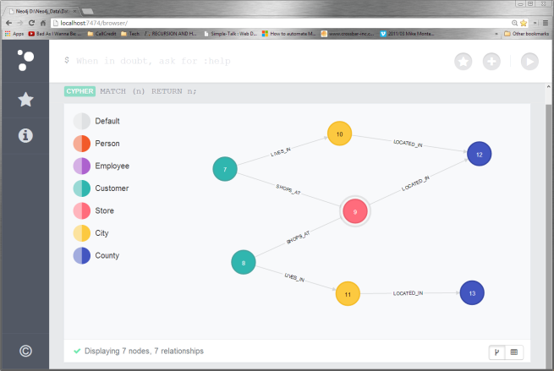
Neo4j - Demo
Notes:
The best way to understand the basics of Neo4j is by example – so. let’s go straight to a demo

Slide 52
Neo4j - Demo
Business Process -> Sketch -> Model
Client access (Neo4jClient)
Lots more from me here:
http://alexdgarland.com/category/neo4j

Slide 53
Neo4j
GOOD | BAD
Expressive Data Model | New approach/ data model to learn
Easy to install, use | Scalability limits similar to relational
Optimised for related data
Strong theoretical roots
Greater flexibility (vs. relational)
Retain ACID semantics (etc.)
Built-in algorithms (e.g. Dijkstra/ A*)

Slide 54
Mixed Architectures
“Polyglot Persistence” (Fowler)
Business Process Requirements
Read-Write Split:
Reporting Database
Data Warehousing
CQRS

Slide 55
Business Processes (Amazon)
AP for shopping cart, recommendations
CP for (e.g.) financial transactions
highscalability.com/amazon-architecture
Notes:
From High Scalability:
“For the checkout process you always want to honor requests to add items to a shopping cart because it's revenue producing. In this case you choose high availability. Errors are hidden from the customer and sorted out later.” “When a customer submits an order you favor consistency because several services--credit card processing, shipping and handling, reporting--are simultaneously accessing the data.”

Slide 56
Reporting Systems
Traditional application/ BI division
“Operational Data Store”
Data Warehouse/ Marts
OLTP/ OLAP
Newer solutions (e.g., Cassandra & Hadoop)

Slide 57
CQRS
“Command-Query Responsibility Segregation”
Stronger version of “Reporting Database” – stricter segregation of reads
Can pair with “Event Sourcing” – commutative operations
Notes:
Event Stores ….
Quick note – commutativity is a really interesting approach to having AP systems without major consistency concerns, as we don’t need to worry about overall order of operations (serialisability) it makes “eventual consistency” more achievable and reliable. There are obviously some considerations around how this is implemented and when it’s a practicable approach, but for example Commutative Replicated Data Types are another way to apply it, more details (e.g.) here: http://highscalability.com/blog/2010/12/23/paper-crdts-consistency-without-concurrency-control.html

Slide 58
CQRS
(PUT DIAGRAM HERE)

